Slide 2
Disclaimer: This presentation is prepared by trainees of baabtra as a part of mentoring program. This is not official document of baabtra –Mentoring Partner
Baabtra-Mentoring Partner is the mentoring division of baabte System Technologies Pvt . Ltd

Slide 3
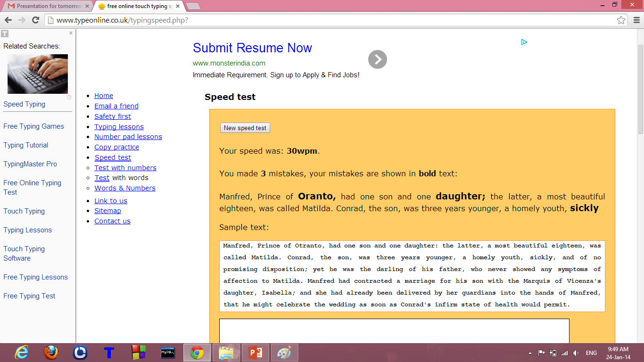

Slide 4


DOM STRUCTURE
Jaseena A P
jsnp65@gmail.com
www.facebook.com/Jaseena Muhammed A P
twitter.com/username
in.linkedin.com/in/profilename
9539443588

Slide 5
WHAT IS DOM?
The DOM is a W3C (World Wide Web Consortium) standard.
"The W3C Document Object Model (DOM) is a platform and language-neutral interface that allows programs and scripts to dynamically access and update the content, structure, and style of a document.“
The DOM defines the objects and properties of all document elements, and the methods (interface) to access them.

Slide 6
DOM
The DOM is separated into 3 different parts / levels:
Core DOM - standard model for any structured document
XML DOM - standard model for XML documents
HTML DOM - standard model for HTML documents
The DOM is accessible only when the whole document has been loaded.That’s the reason the DOM access code is executed only after the load event has been fired.

Slide 7
HTML DOM
The HTML DOM defines a standard way for accessing and manipulating HTML documents.
The HTML DOM is platform and language independent and can be used by any programming language like Java, JavaScript, and VBScript.

Slide 8
Features of DOM
A standard object model for HTML
A standard programming interface for HTML
Platform- and language-independent
A W3C standard.
The HTML DOM is a standard for how to get, change, add, or delete HTML elements.
The HTML DOM defines the objects and properties of all HTML elements, and the methods (interface) to access them.

Slide 9
DOM NODES
According to the DOM, everything in an HTML document is a node.
The entire document is a document node
Every HTML tag is an element node
The text in the HTML elements are text nodes
Every HTML attribute is an attribute node
Comments are comment nodes

Slide 10

HTML DOM Node Tree (Document Tree)
All the nodes in a node tree have relationships to each other.
The tree structure is called a node-tree.

Slide 11
HTML DOM Node Tree (Document Tree)
In a node tree, the top node is called the root
Every node, except the root, has exactly one parent node
A node can have any number of children
A leaf is a node with no children
Siblings are nodes with the same parent

Slide 12
AN EXAMPLE
<html>
<head>
<title>DOM</title>
</head>
<body>
<h1>I am in DOM world</h1>
<p id=“intro”>Hello DOM!</p>
</body>
</html>
The <html> node has no parent node; the root node
The parent node of the <head> and <body> nodes is the <html> node
The parent node of the "Hello world!" text node is the <p> node

Slide 13
DOM EXAMPLE
Most element nodes have child nodes:
The <html> node has two child nodes; <head> and <body>
The <head> node has one child node; the <title> node
The <title> node also has one child node; the text node "DOM “
The <h1> and <p> nodes are siblings, and both child nodes of <body>

Slide 14
HTML DOM-ACCESS NODES
We can access a node in three ways:
By using the getElementById() method
2. By using the getElementsByTagName() method
3. By navigating the node tree( using the node relationships ).

Slide 15
The getElementById() Method
getElementById();
method returns the element with the specified ID
Syntax
node.getElementById("someID");
The getElementByTagName() Method
getElementsByTagName();
returns all elements with a specified tag name.
Syntax
node.getElementsByTagName("tagname");

Slide 16
Example
<html>
<body>
<p id="intro">W3Schools example</p>
<div id="main">
<p id="main1">The DOM is very useful</p>
<p id="main2">This example demonstrates how to use the <b>getElementsByTagName</b> method</p>
</div>
<script type="text/javascript">
x=document.getElementById("main").getElementsByTagName("p");
document.write("First paragraph inside the main div: " + x[0].childNodes[0].nodeValue);
</script>
</body>
</html>

Slide 17
Navigating Node Relationships
The three properties parentNode, firstChild, and lastChild follow the document structure and allow short-distance travel in the document.
<html>
<body>
<p id="intro">W3Schools example</p>
<div id="main">
<p id="main1">The DOM is very useful</p>
<p id="main2">This example demonstrates <b>node Relationships</b>
</p>
</div>
</body>
</html>

Slide 18
Navigating Node Relationships
The <p id="intro"> is the first child node (firstChild) of the <body> element, and the <div> element is the last child node (lastChild) of the <body> element.
Furthermore, the <body> is the parent (parentNode) .
The firstChild property can be used to access the text of an element.
x=document.getElementById(“main"); var text=x.firstChild.firstChild.nodeValue;

Slide 19
DOM Advantages & Disadvantages
ADVANTAGES
Robust API for the DOM tree
Relatively simple to modify the data structure and extract data
Disadvantages
Stores the entire document in memory
As Dom was written for any language, method naming conventions don’t follow standard java programming conventions

Slide 20
THANK YOU

Slide 21
If this presentation helped you, please visit our page facebook.com/baabtra and like it.
Thanks in advance.
www.baabtra.com | www.massbaab.com |www.baabte.com

Slide 22

Contact Us
Emarald Mall (Big Bazar Building) Mavoor Road, Kozhikode, Kerala, India. Ph: + 91 – 495 40 25 550 |  | NC Complex, Near Bus Stand Mukkam, Kozhikode, Kerala, India. Ph: + 91 – 495 40 25 550
Start up Village Eranakulam, Kerala, India.
Email: info@baabtra.com

